Slide 1
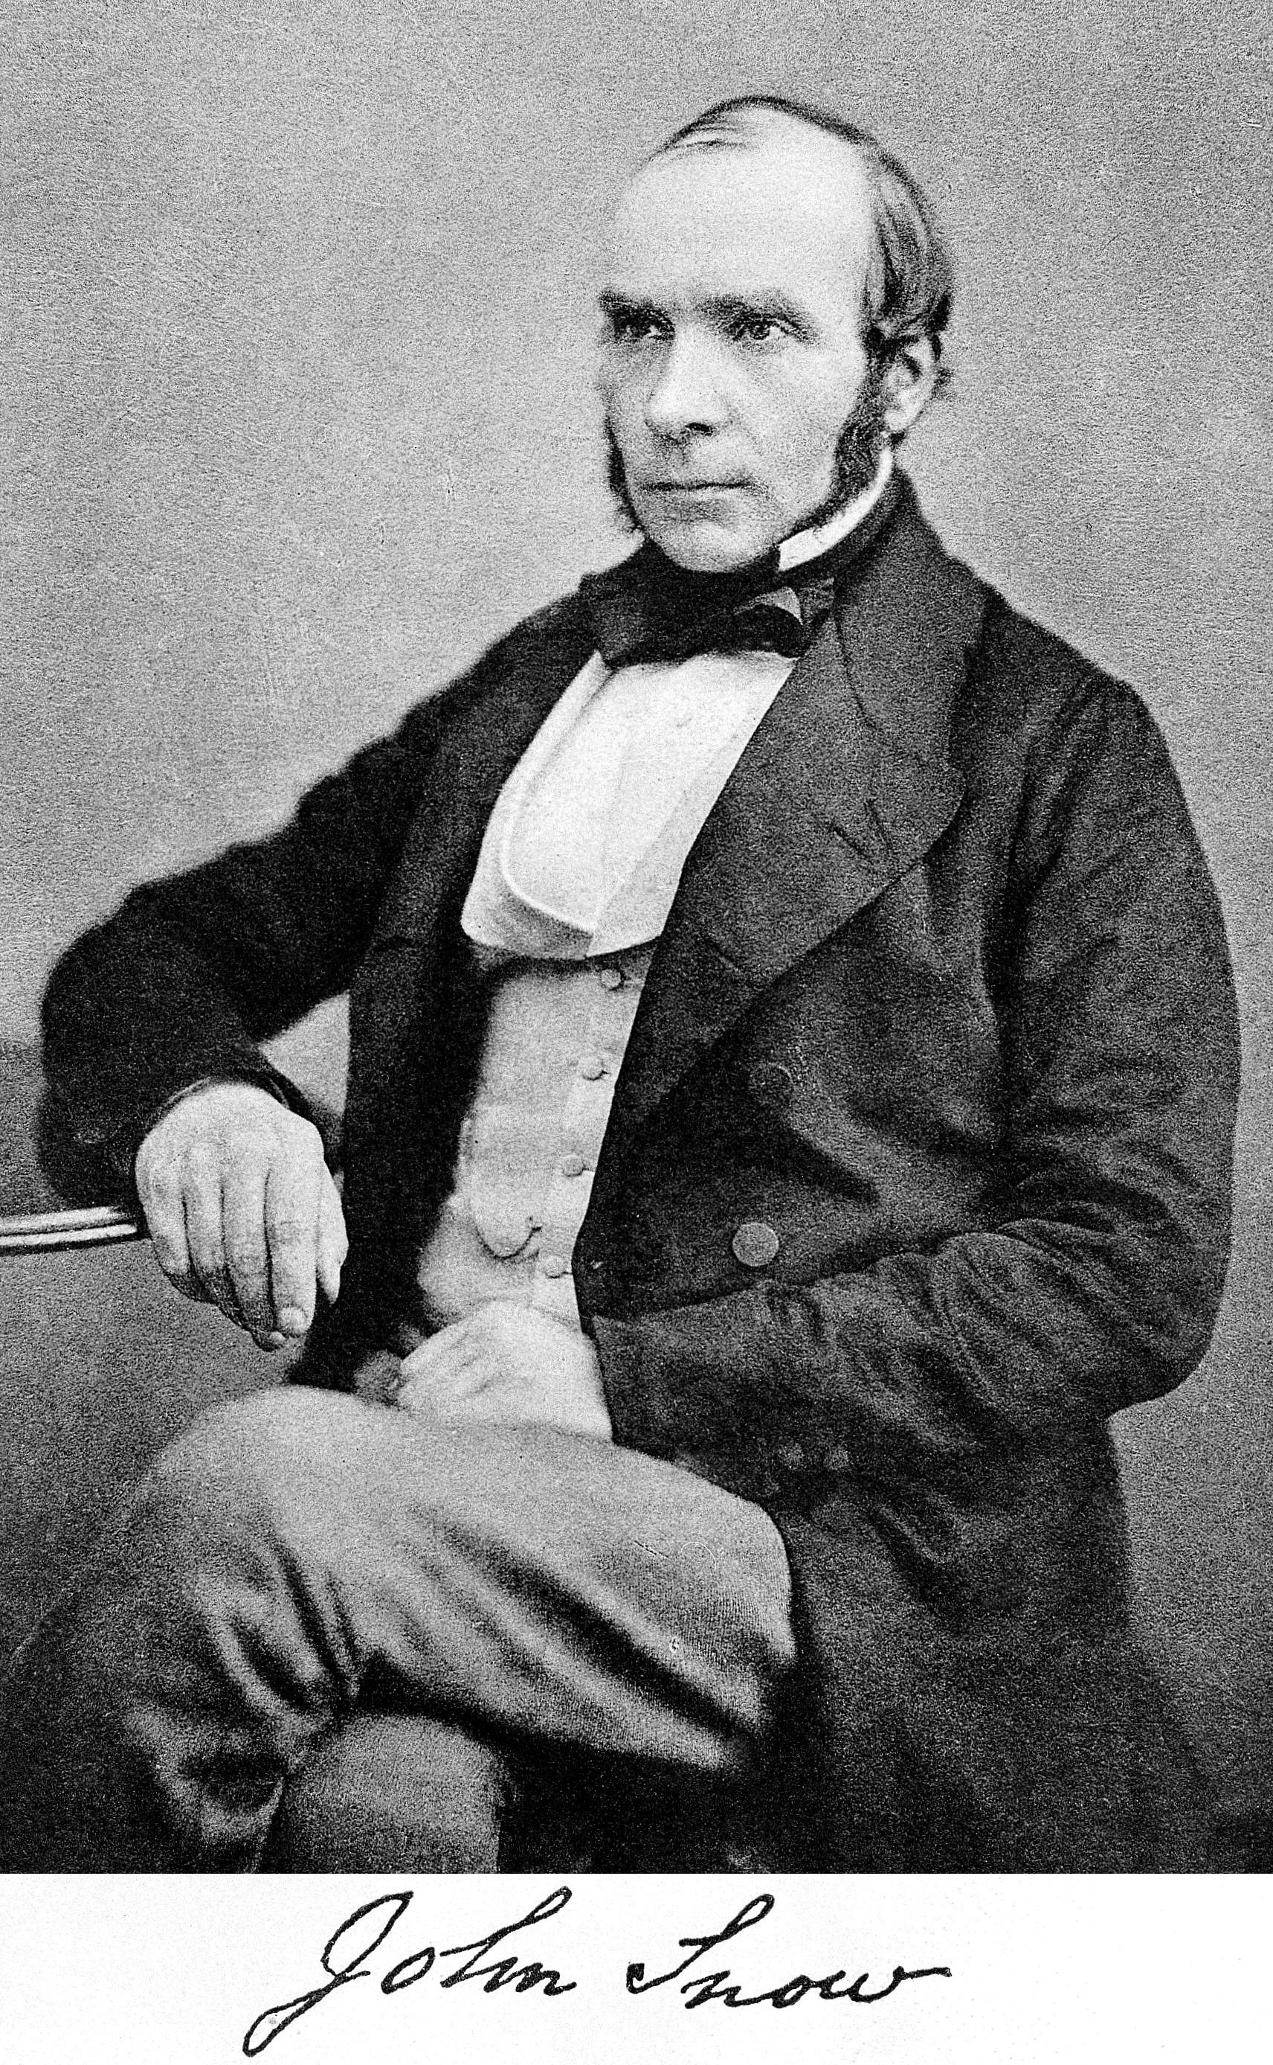
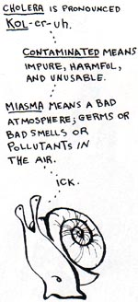
CHOLERA : AN ICKY PROBLEM

Slide 2
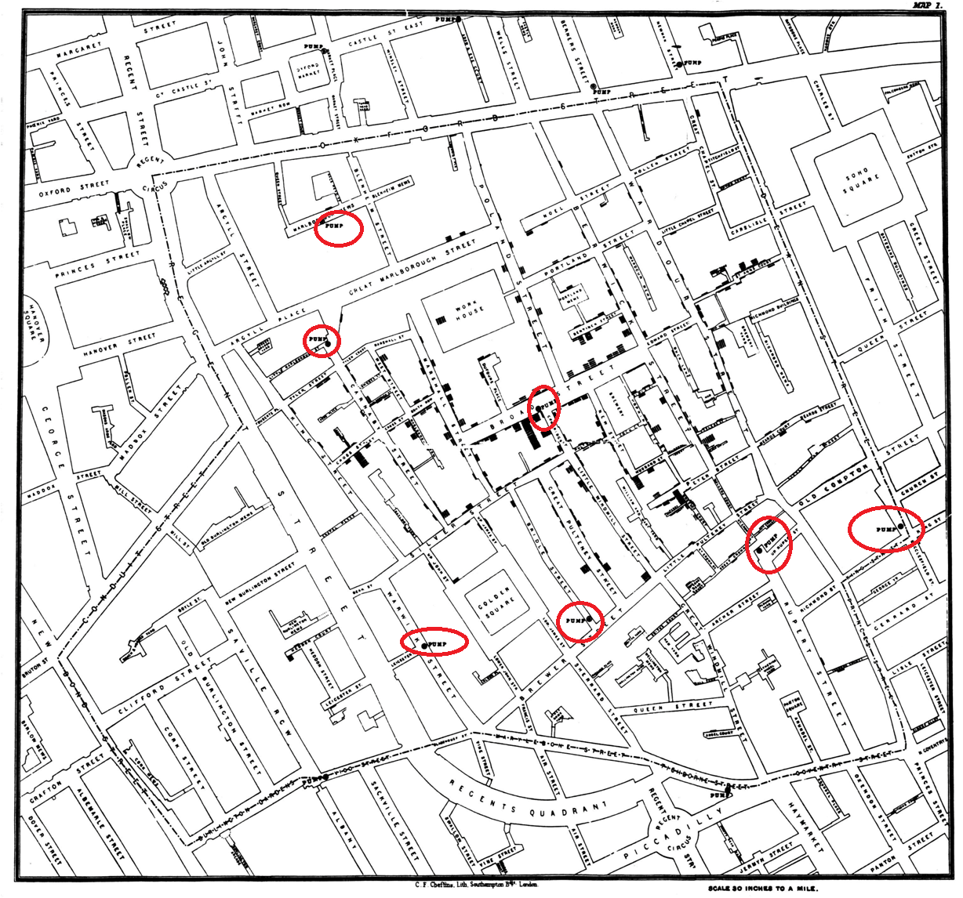

Slide 3
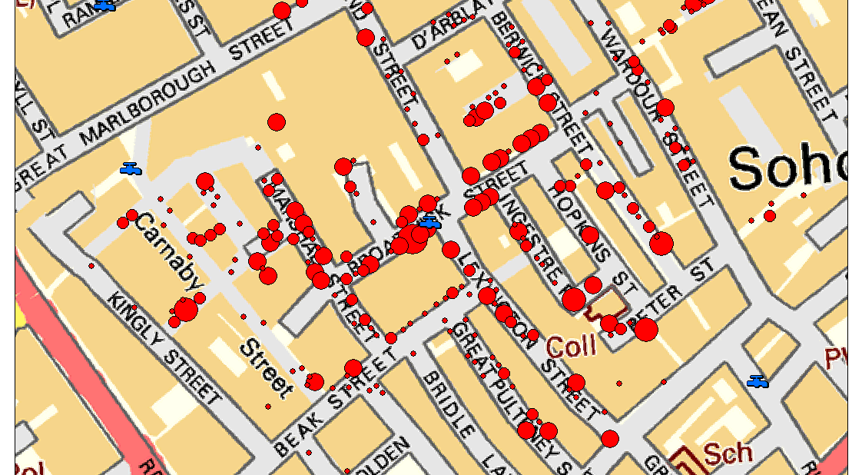

Slide 4
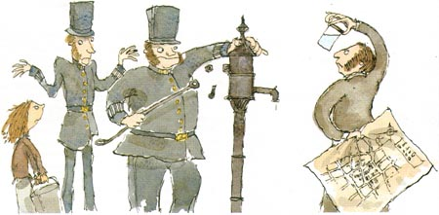

Slide 5
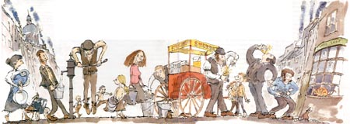

Slide 6
DATA SCIENCE CAMP
ASPIRING MINDS

Slide 7
WHAT IS DATA SCIENCE?
Learning new things happening in the world by collecting data of things that have happened and then visualizing it or by applying math – statistics.
New information!
Old information from various sources

Slide 8
Agriculture
Ways to improve crop growth
Weather information
Soil information
Geographical information

Slide 9
Shopping
Help you find more things you like
What you have bought
When you have bought

Slide 10
Friends
Help you find more people similar to you
Who they are
What they like

